Slide 1
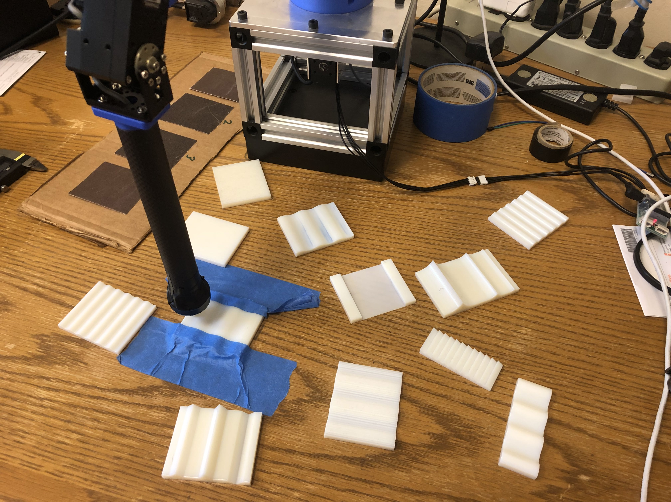
Active haptic perception for surface texture and geometry
Jason Ah Chuen

Slide 2
What is in a surface?
1) Geometry
Descriptors: Flat, wavy, repeating geometrical shape (e.g. triangular or rectangular ridges/ravines etc.), irregular shape
Macro
2) Texture
Descriptors: Smooth, rough, coarse, grainy
3) Friction
Descriptors: slippery, non-slippery
Micro

Slide 3
The Problem
Finding the texture and geometry of a surface, using kinesthetic and vibrational cues.
But, overlap between texture and geometry. How do you distinguish between both?

Slide 4
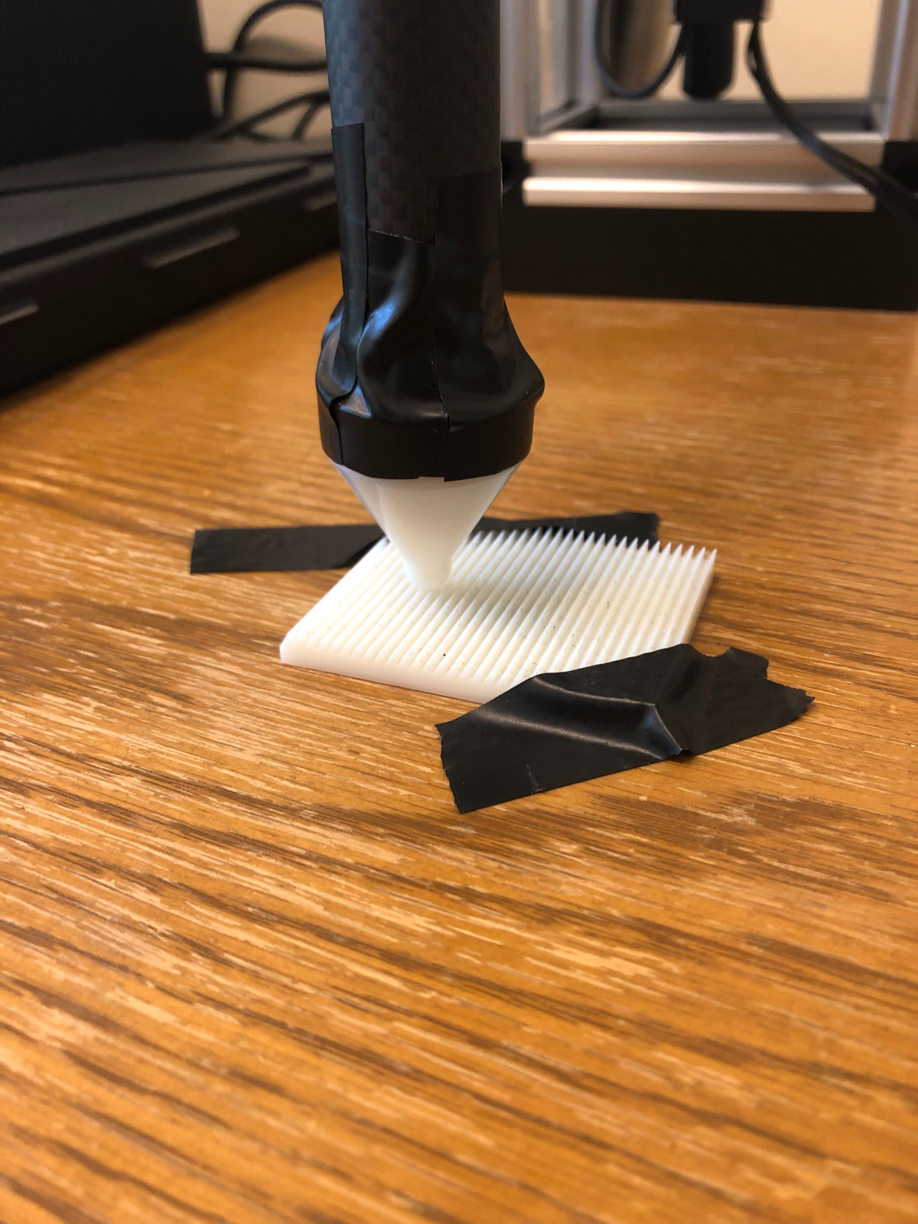
Methods
“Stroking” exploratory procedure
Current scan:
Joint 1 motor A is operated on current-based control mode (in the vertical direction) and joint 1 motor B is operated on position control mode (in the horizontal direction).
Position scan:
Joint 1 motors A and B are operated in position control mode (in both the vertical and horizontal direction)

Slide 5
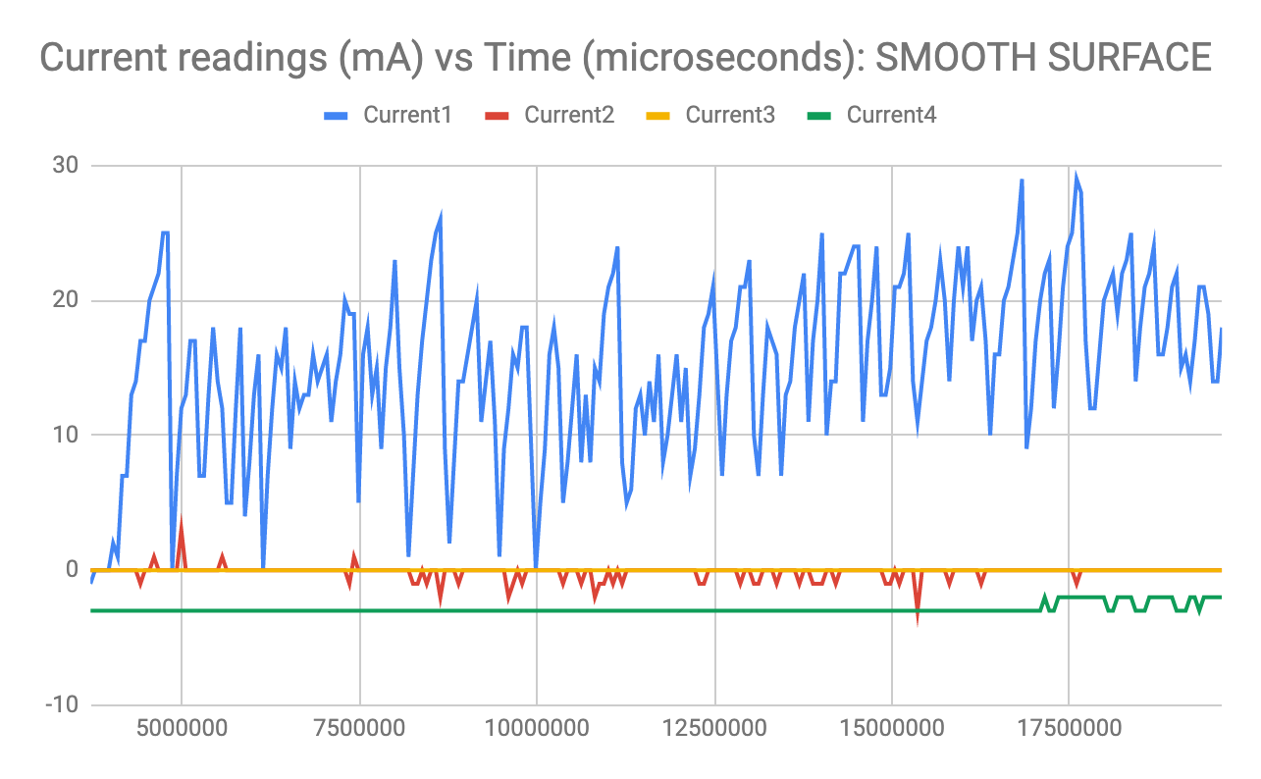
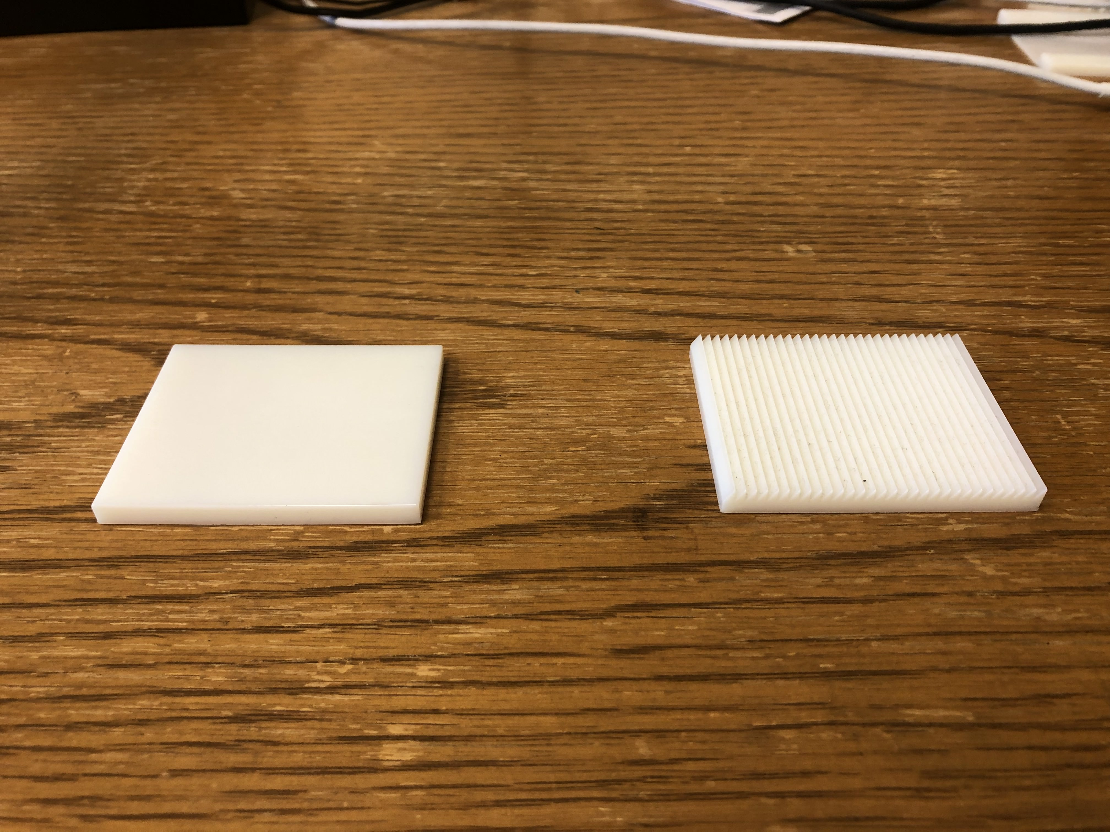
Analysis – texture

Slide 6
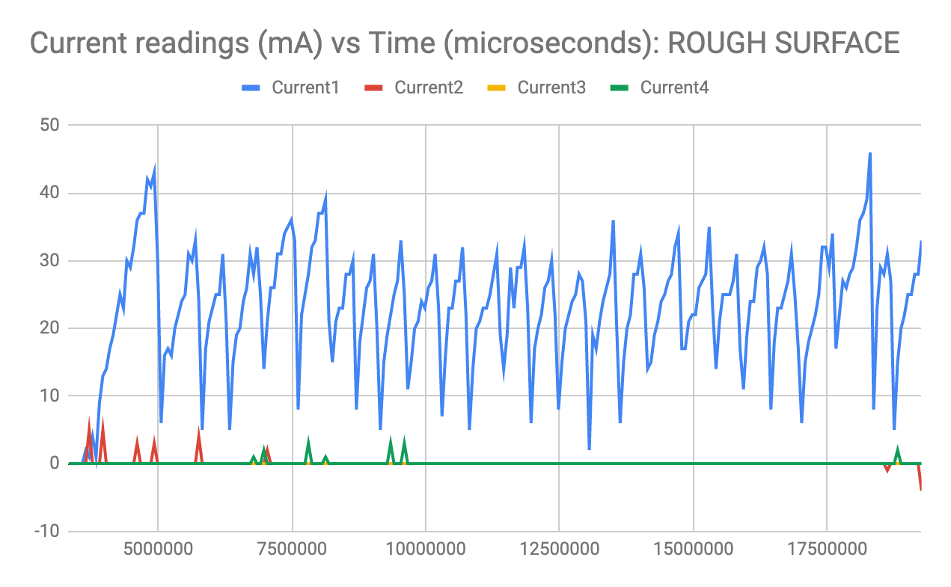
Analysis - texture
Fig 1A (s.d1 = 6.79, s.d2 = 2.51, s.d3 = 0)
Fig 1B (s.d1 = 8.81, s.d2 = 0.64, s.d3 = 0)
Note that the axes have different scales

Slide 7
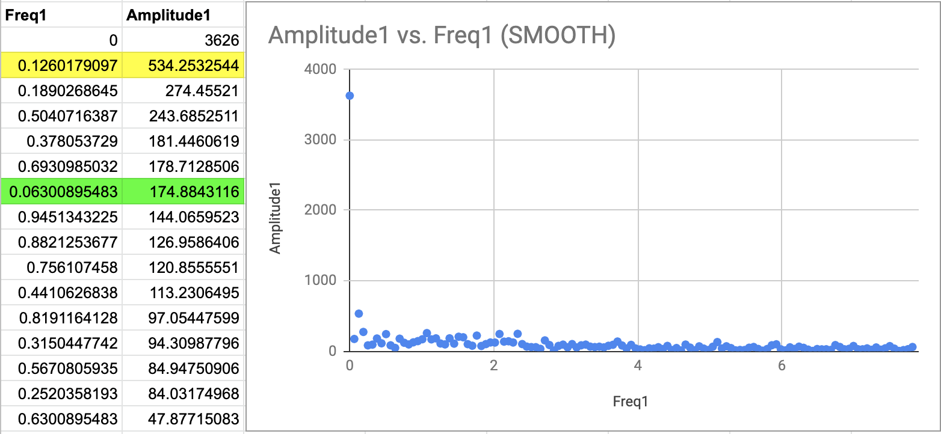
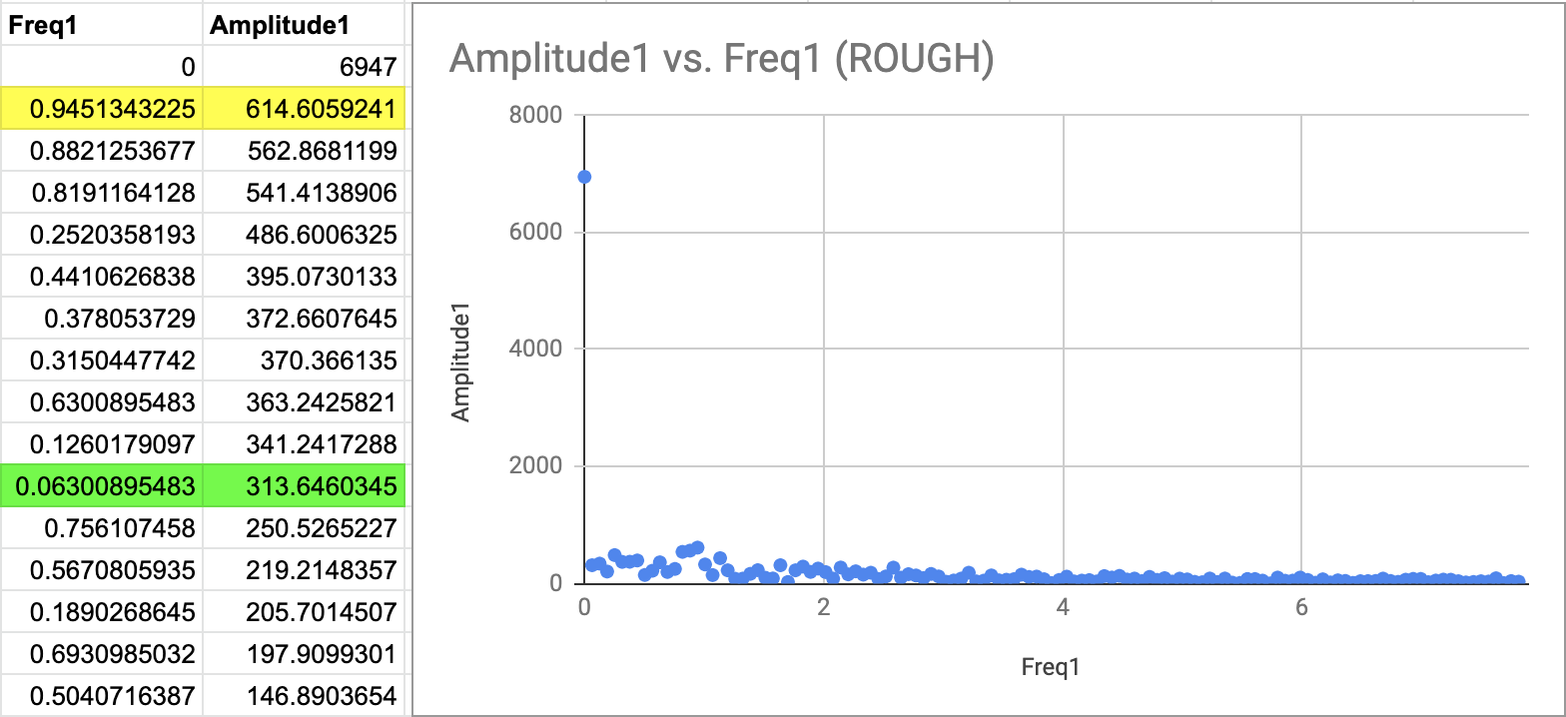
Analysis - texture
High amplitude at 0 unit
Discrete frequencies only
Outlier point having a very small frequency at 0.063 Hz

Slide 8
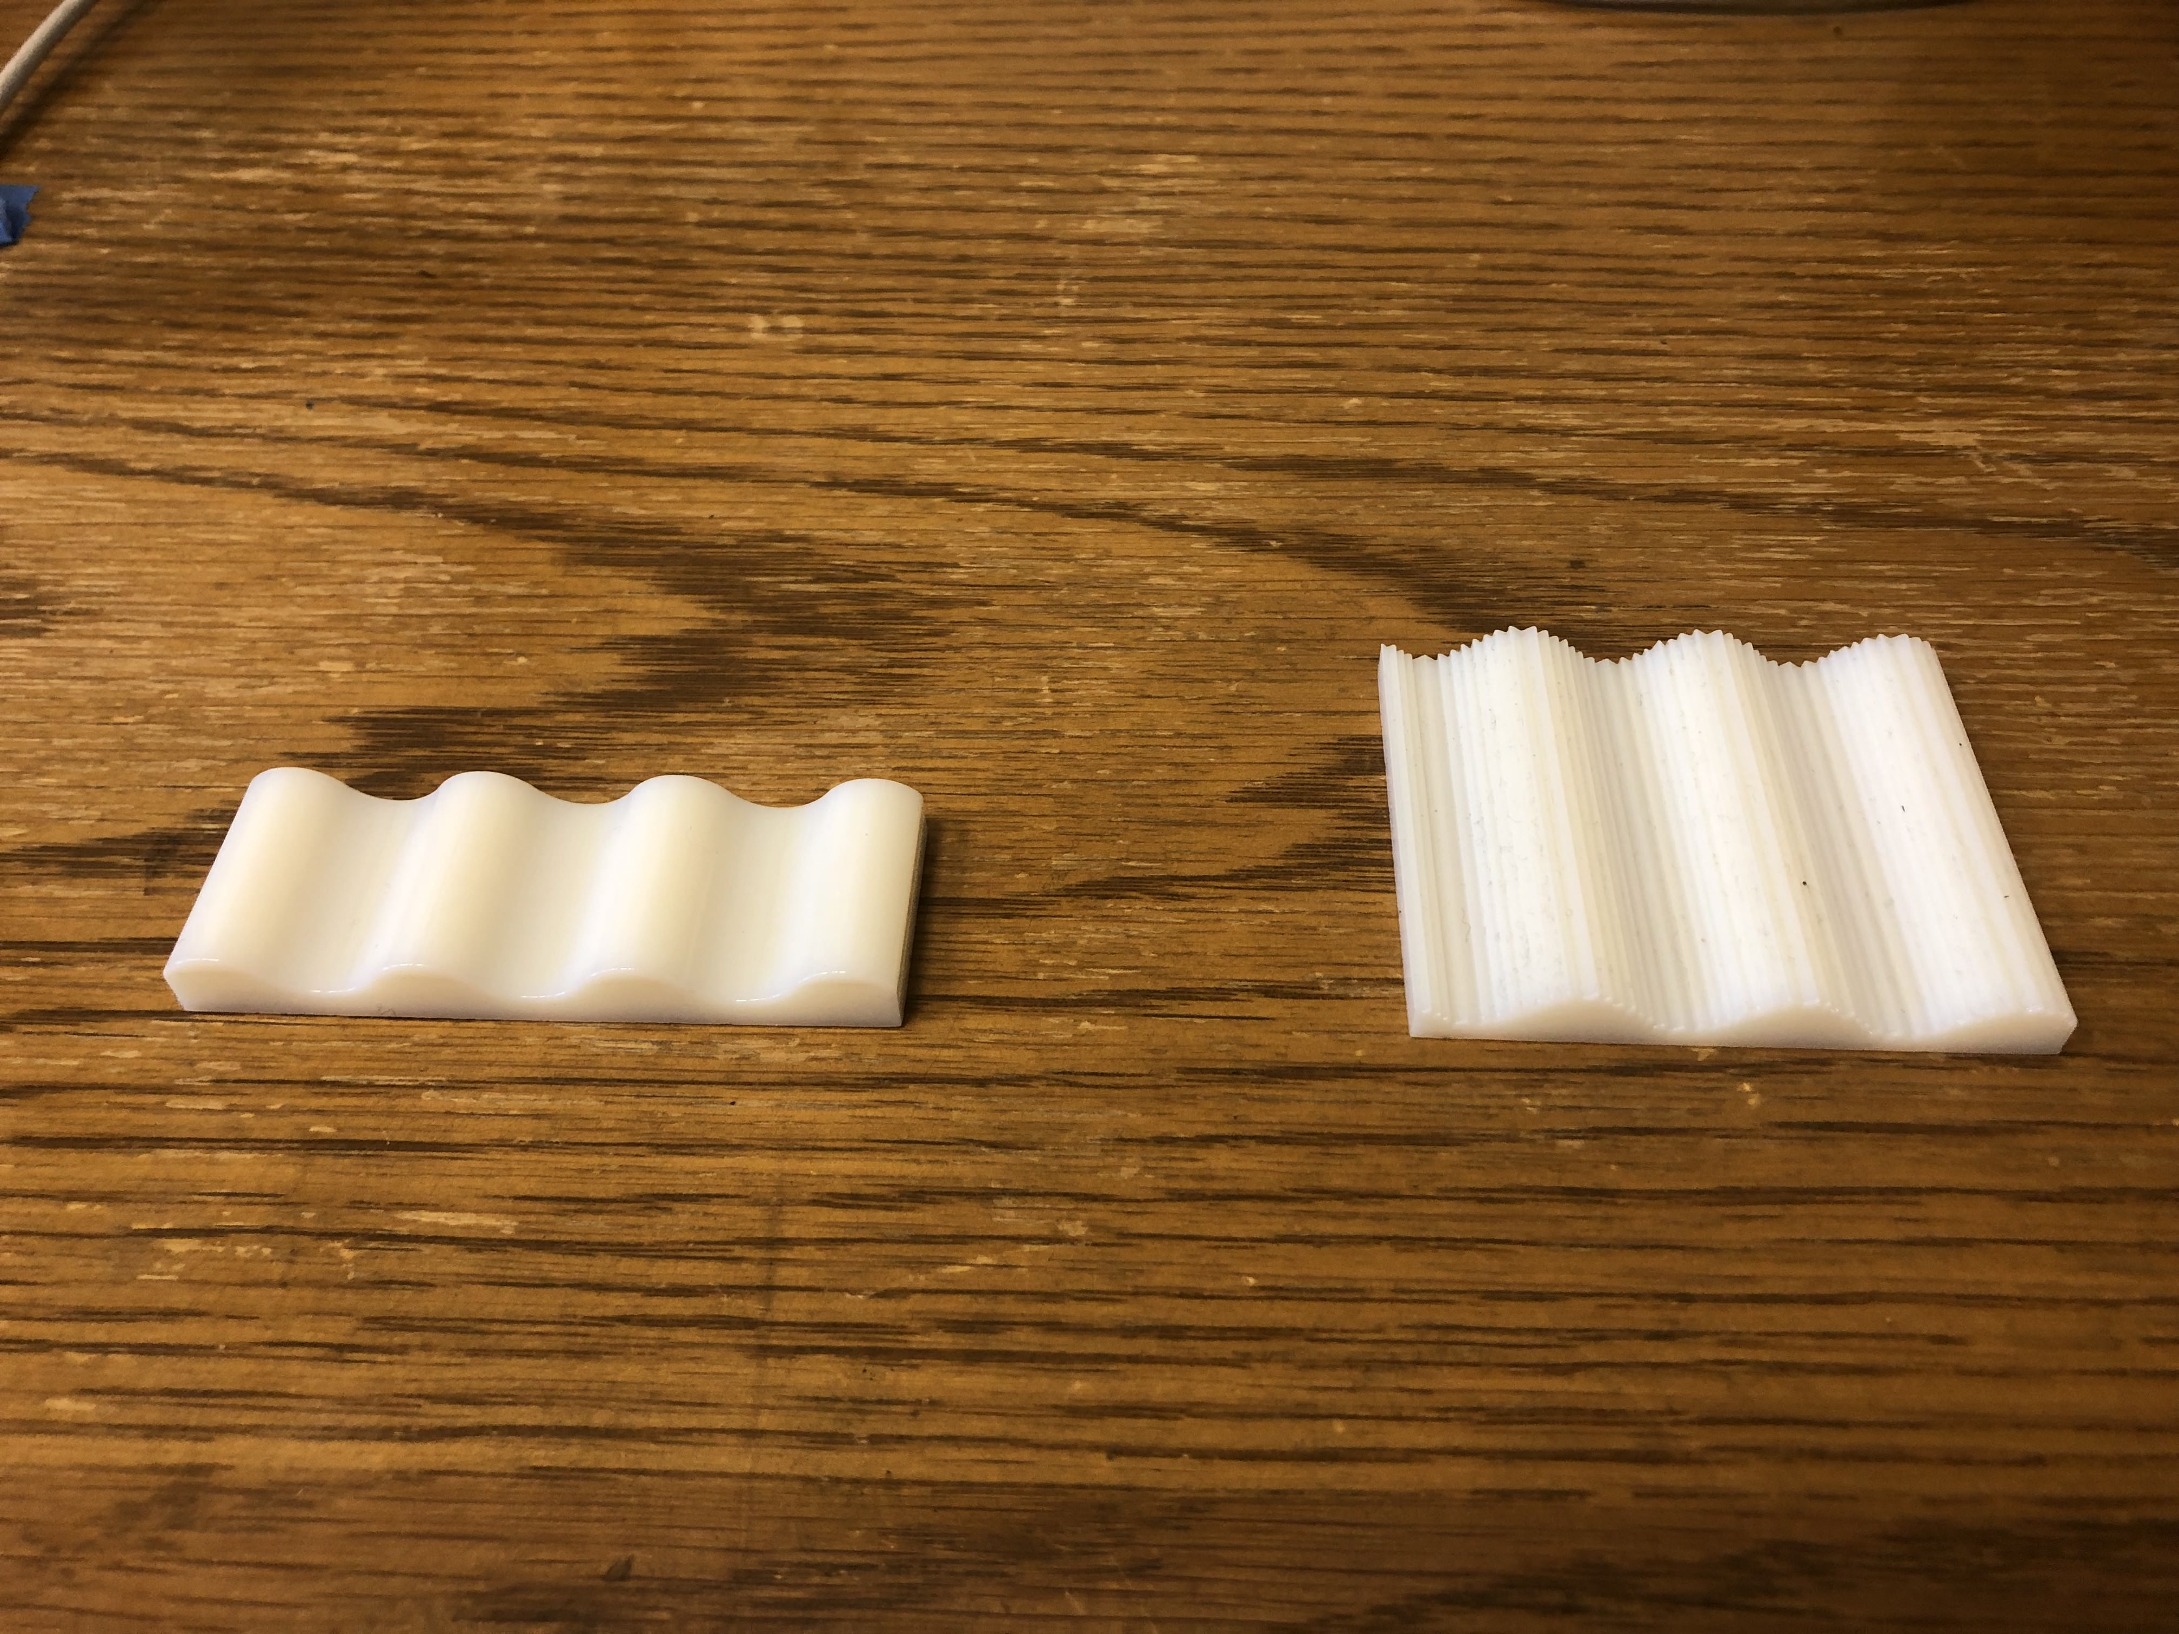
Analysis – geometry

Slide 9
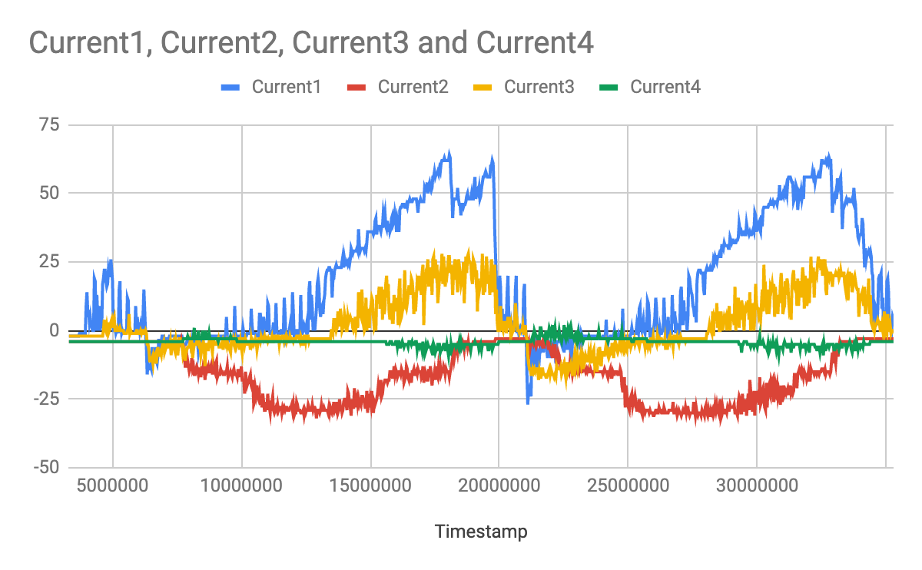
Analysis – geometry
Flat Surface
Wavy surface
Fig 2A (s.d1 = 6.79, s.d2 = 2.51, s.d3 = 0)
Fig 2B (s.d1 = 23, s.d2 = 7.116, s.d3 = 0.2)

Slide 10
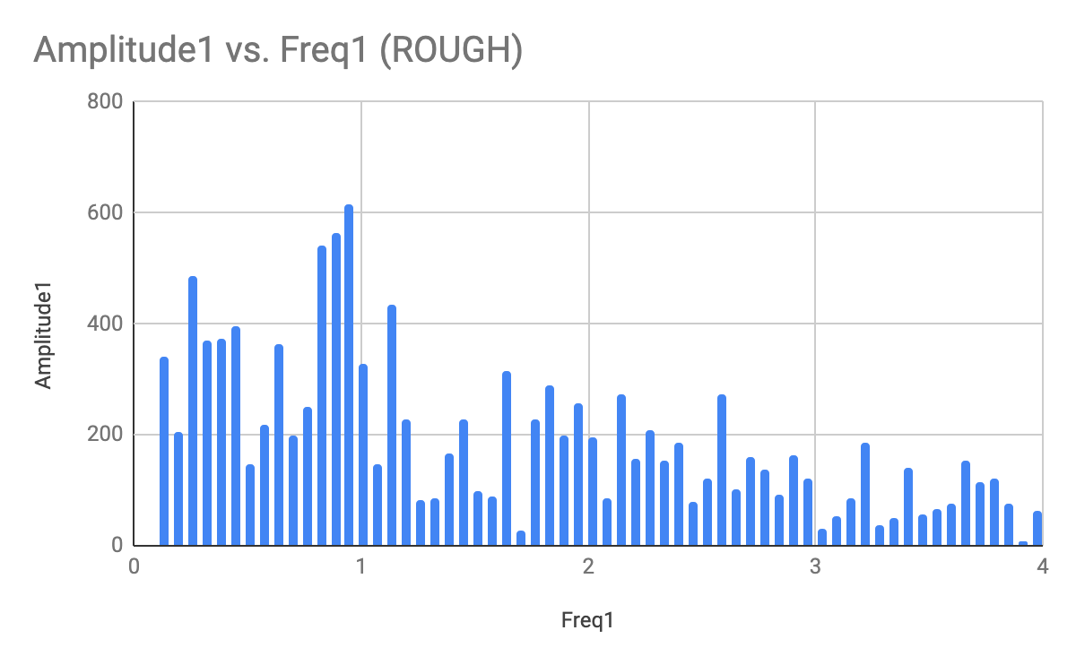
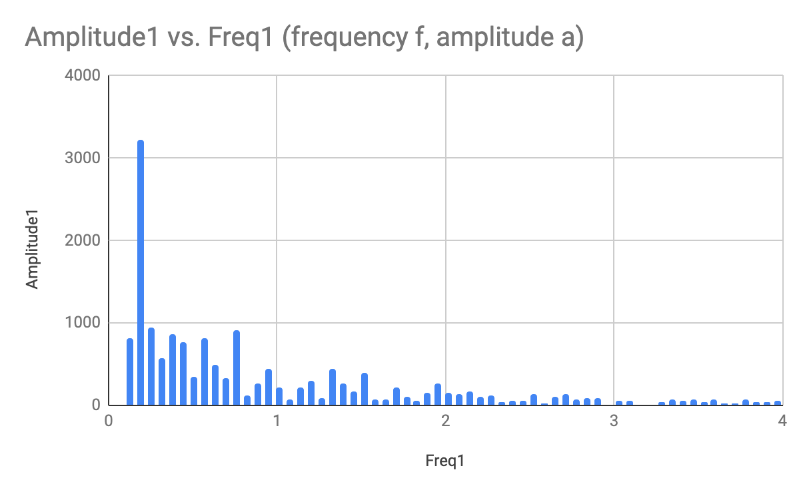
Analysis – geometry
Flat Surface
Wavy surface

Slide 11
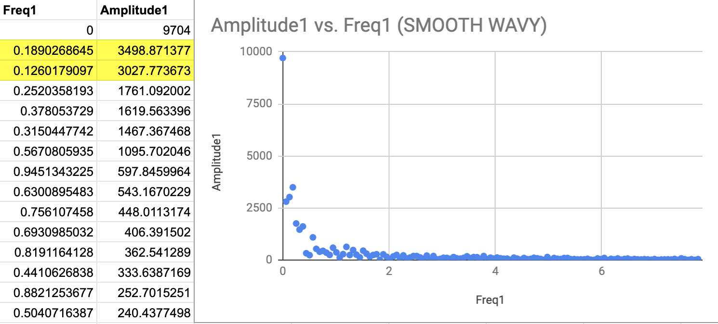
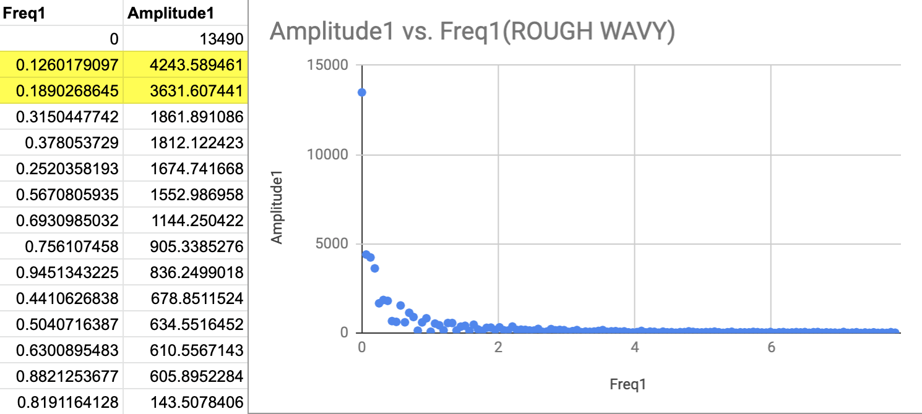
Analysis - geometry
What would happen if a surface has both geometry and texture?
The range of frequencies at which the amplitudes are highest is the practically the same
Hence, showing geometry predominates over texture

Slide 12
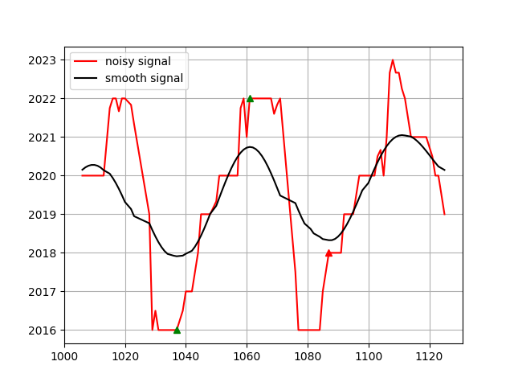
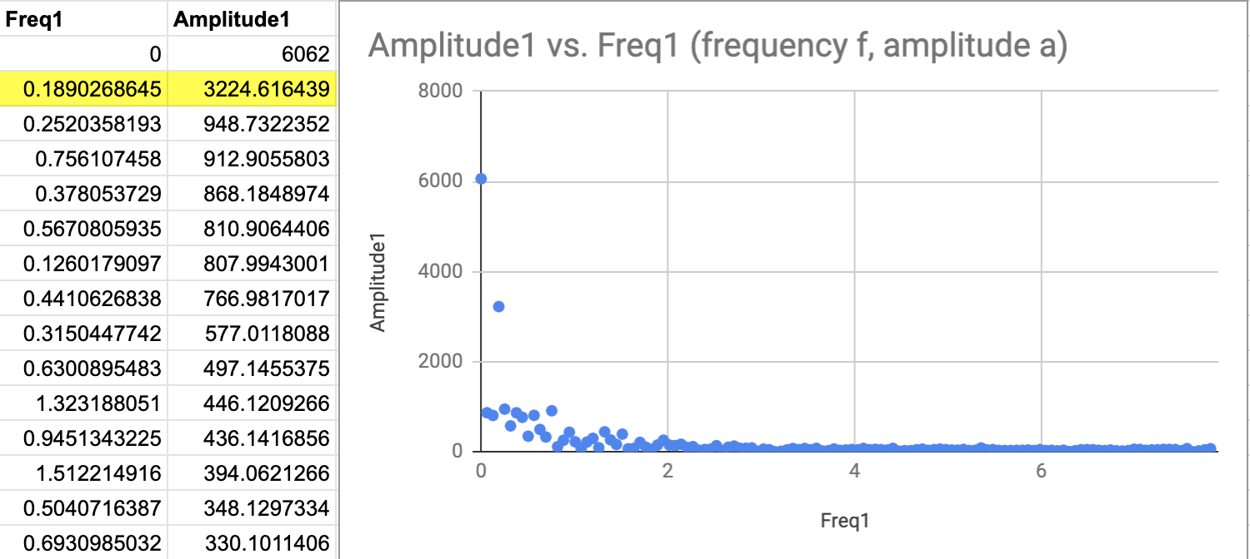
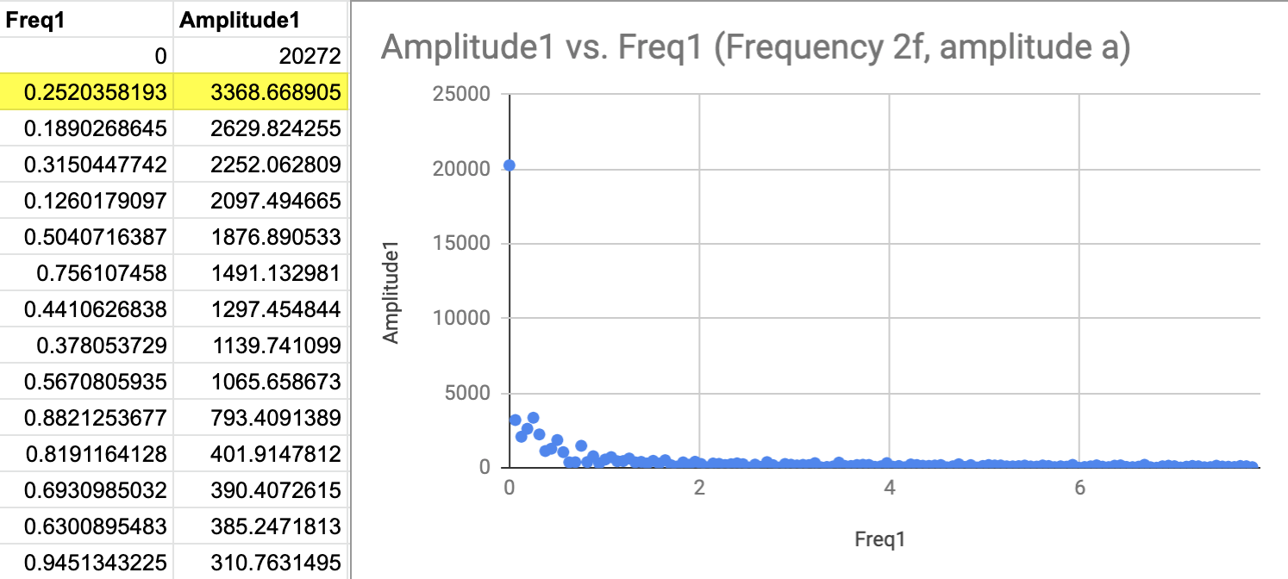
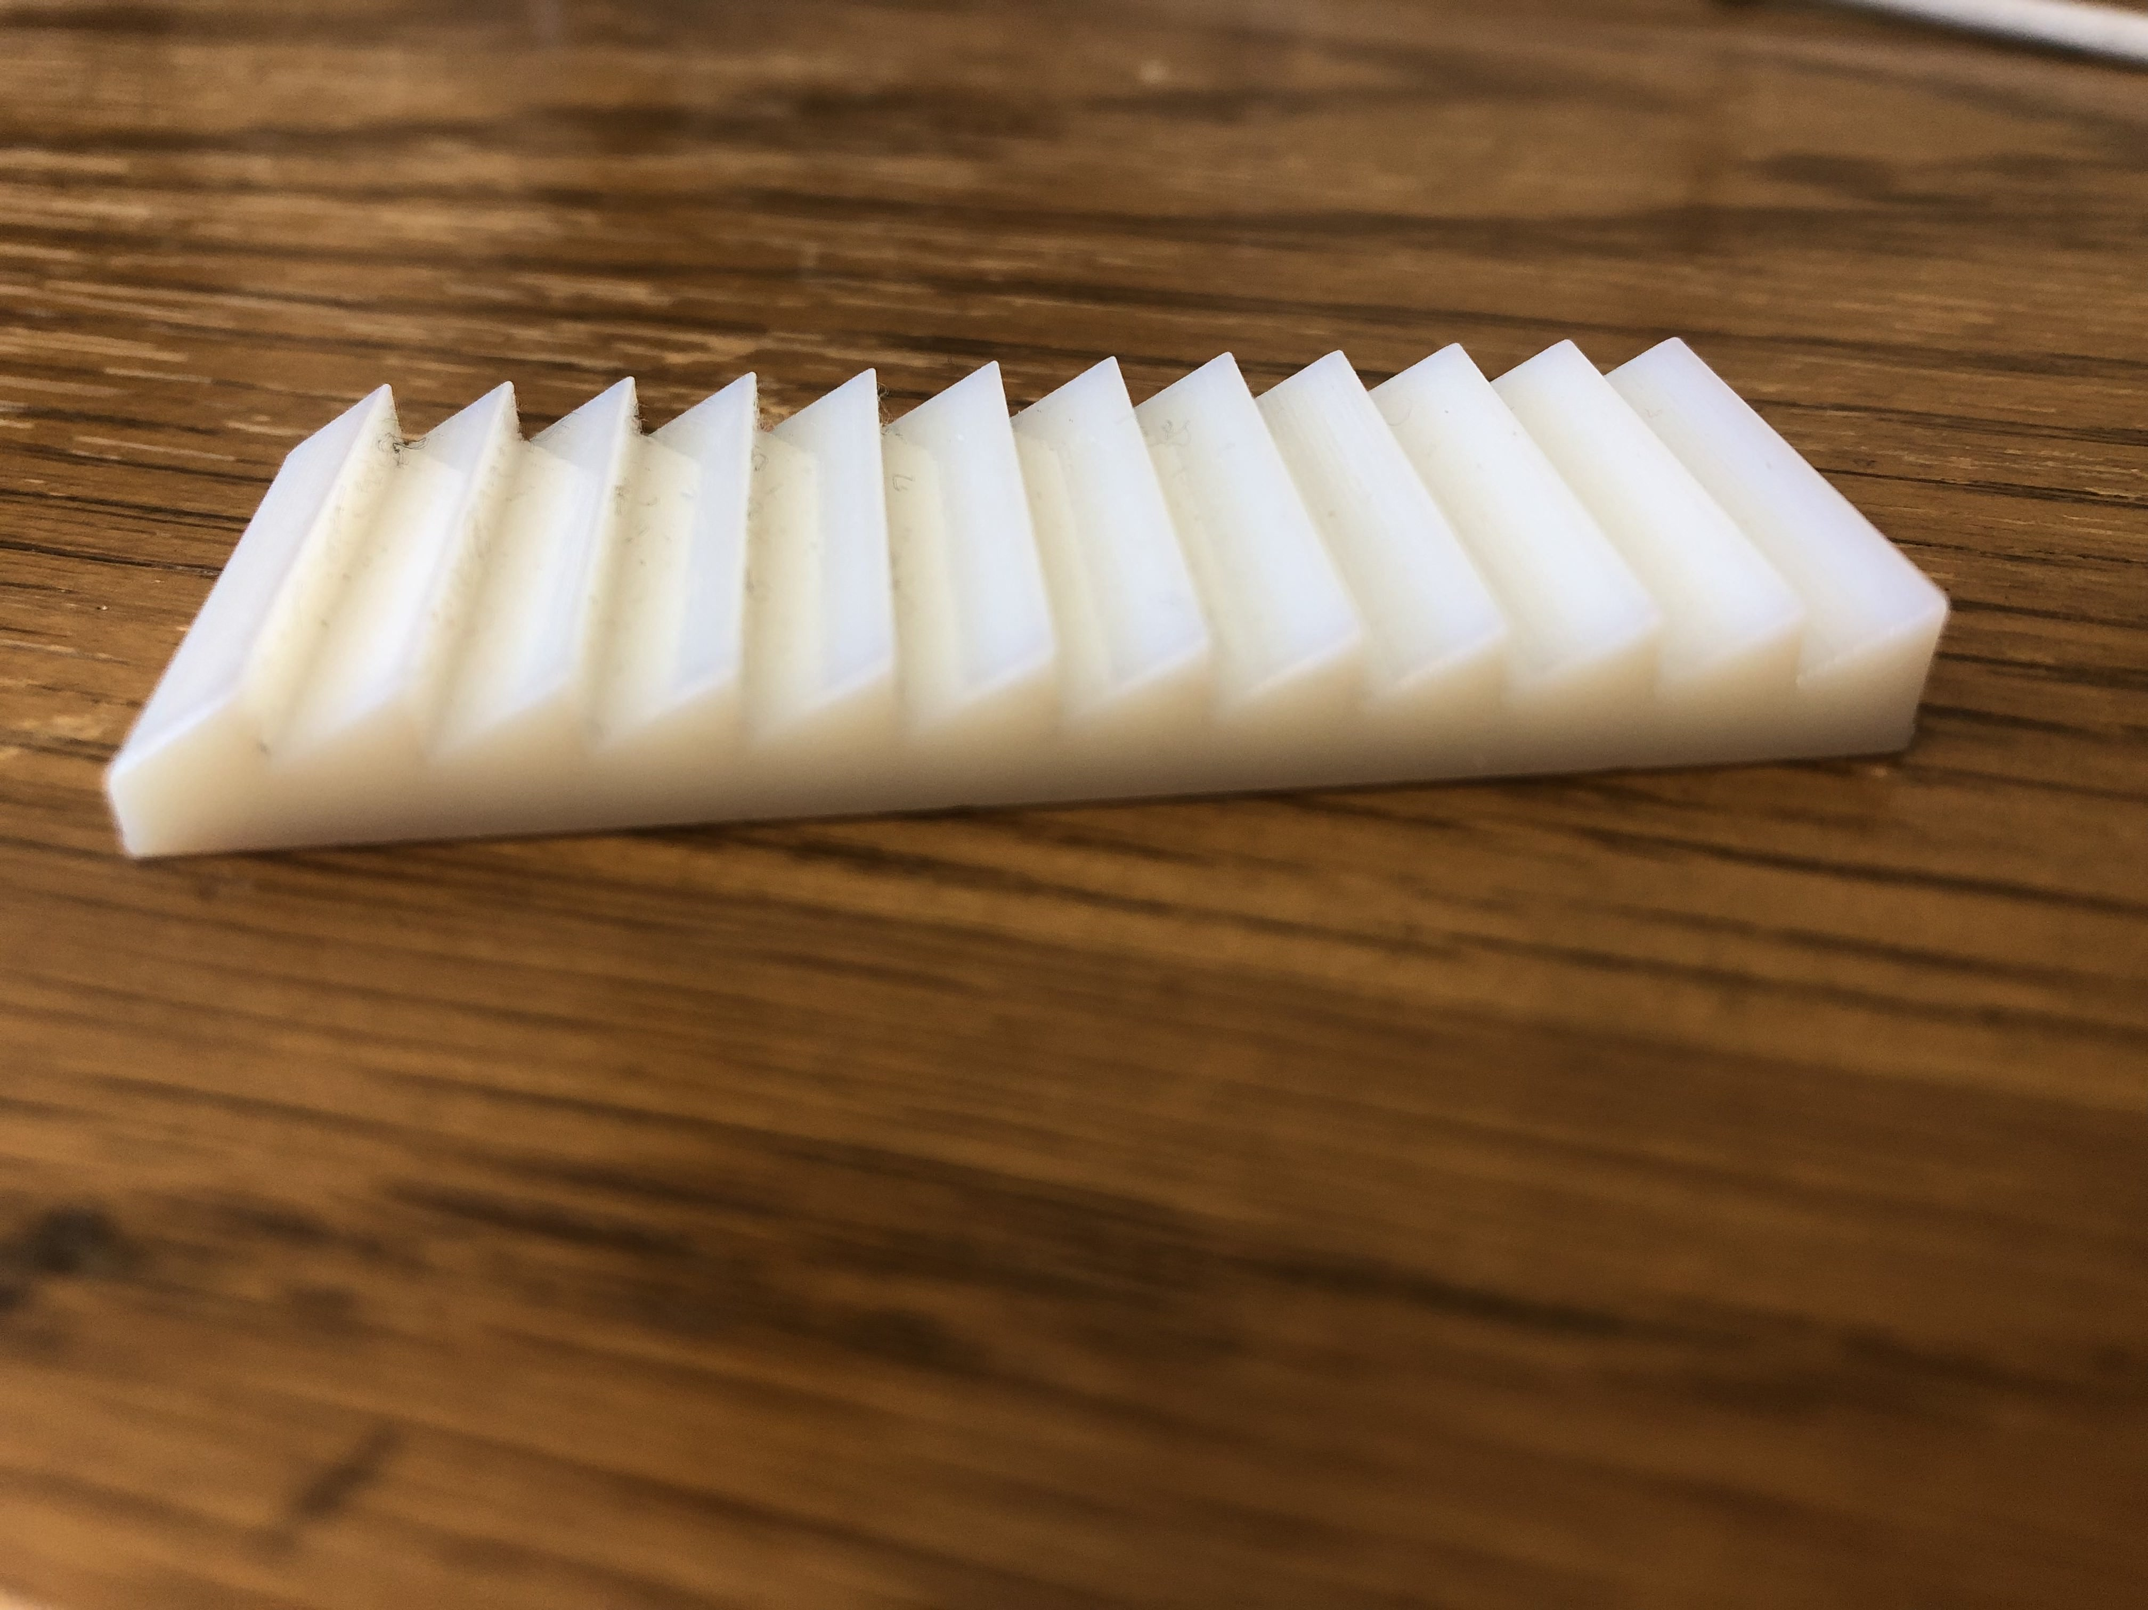
Analysis - geometry
What would happen if the spatial frequency changes?
As the spatial frequency of the surface doubled, so did the frequency at which the amplitude is highest, which is the frequency of the characteristic wave.
Hence, we can tell at what frequency this geometry is repeating itself

Slide 13
Analysis - geometry
To find out the geometry, use position scan
Remove noise from signal
Use first and second derivatives to find any maxima or minima
Find variance of the separation of the peaks. If variance close to 0, then it is a regular geometry

Slide 14
Analysis - geometry
Concave downward:
1st derivative < 0
2nd derivative > 0
Concave upward:
1st derivative < 0
2nd derivative > 0

Slide 15
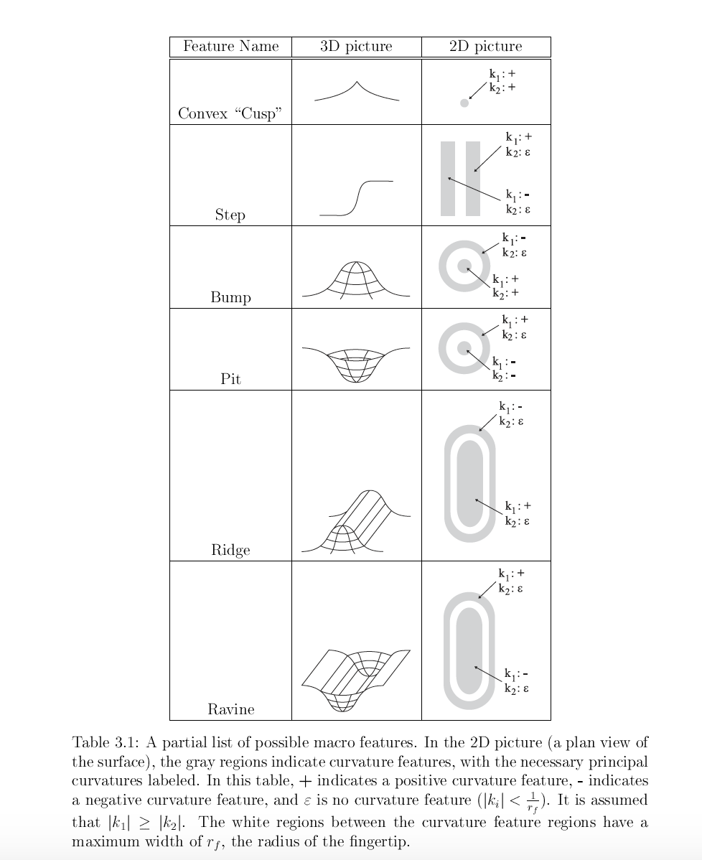
Analysis - geometry
(Okamura, 2000)

Slide 16
Results
Mean value calculated from 3 repeats for each
Geometry | Features/Predictors | Texture
 |  | Smooth | Rough
Flat | s.d1 | 6.79 | 10.71
 | s.d2 | 2.51 | 1.97
 | s.d3 | 0 | 0
 | freq of 1st harmonic | 0.12602 | 0.8821
 | amp of 1st harmonic | 554 | 589
Wavy (f, a) | s.d1 | 23
 | s.d2 | 7.16
 | s.d3 | 0.2
 | freq of 1st harmonic | 0.18902
Wavy (2f, a) | s.d1 | 41.944
 | s.d2 | 7.93
 | s.d3 | 9.129
 | freq of 1st harmonic | 0.25036
 | amp of 1st harmonic | 3369
Wavy (f, 3a) | s.d1 | 36.1 | 43.5
 | s.d2 | 15.56 | 17
 | s.d3 | 5.55 | 7.5
 | freq of 1st harmonic | 0.189027 | 0.063
 | amp of 1st harmonic | 3498 | 4133
Half-triangles | s.d1 | 33.63075949
 | s.d2 | 2.125506057
 | s.d3 | 6.240815331
 | freq of 1st harmonic | 0.378053729
 | amp of 1st harmonic | 2619.643688

Slide 17
Results
Machine learning:
K-Nearest Neighbors (KNN)
Multinomial Logistic Regression
The predictors are the s.d1, s.d2, s.d3, f_main, amp_main

Slide 18
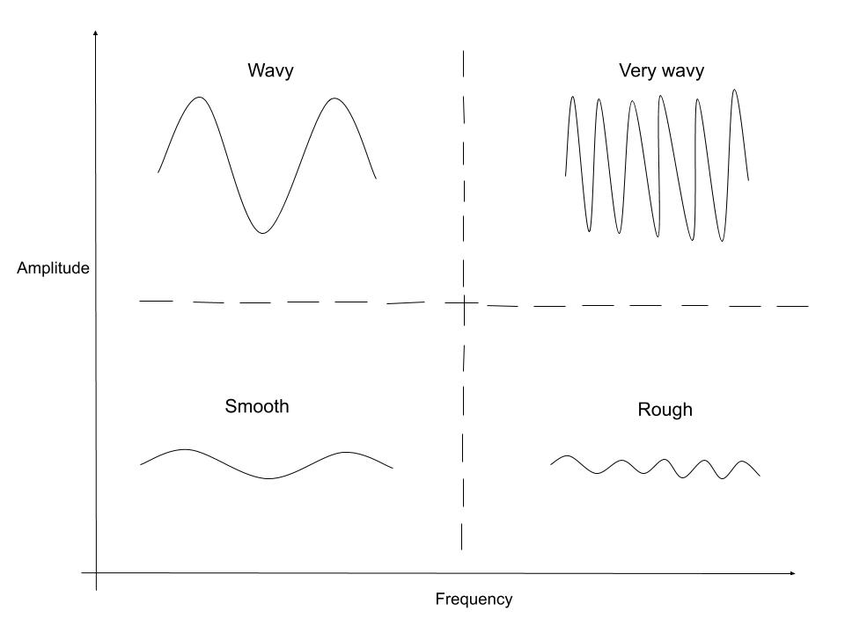
Discussion
Geometry can be considered high amplitude texture

Slide 19
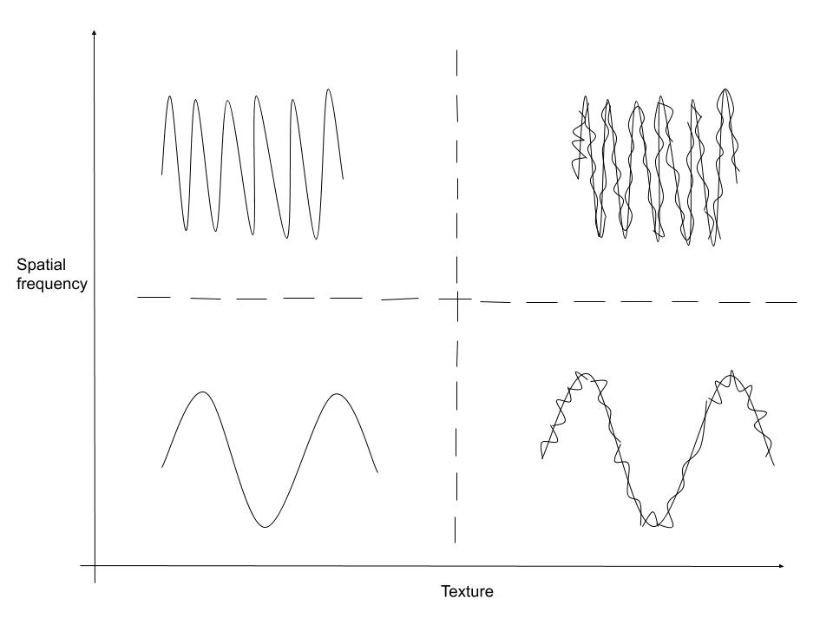
Discussion
Superimposing texture on top of geometry – all different types of surfaces become possible

Slide 20
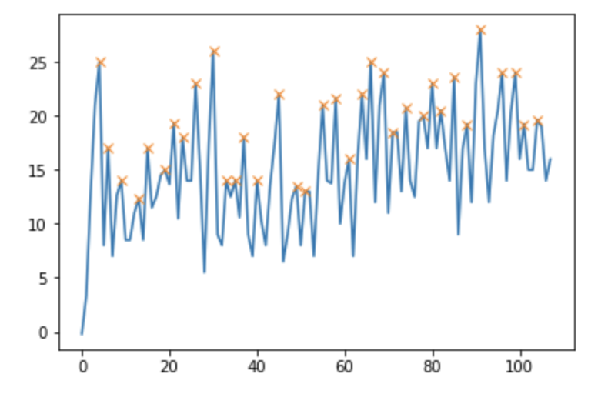
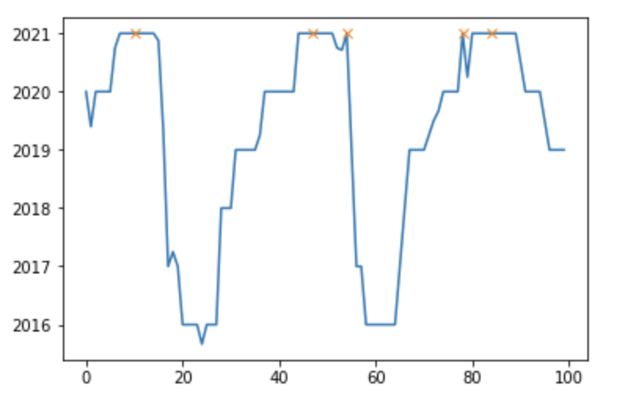
Improvements
By plotting inverse Fourier Transform graphs, separate the texture frequencies from geometry frequencies
Hence, we can identify the texture and geometry separately.
Furthermore, friction coefficients can be calculated for surfaces having geometries. Right now, it can only work on a flat surface, using μ = F_{h}/F_{v}

Slide 21
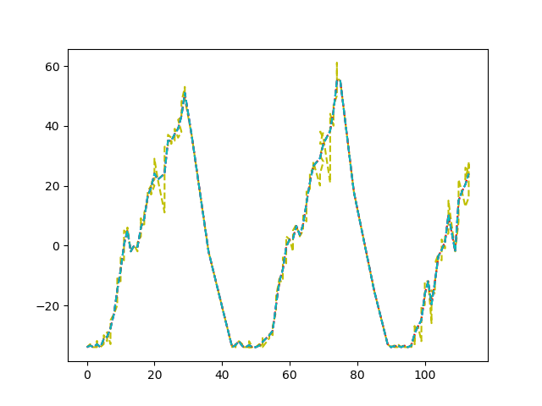


Improvements

Slide 22
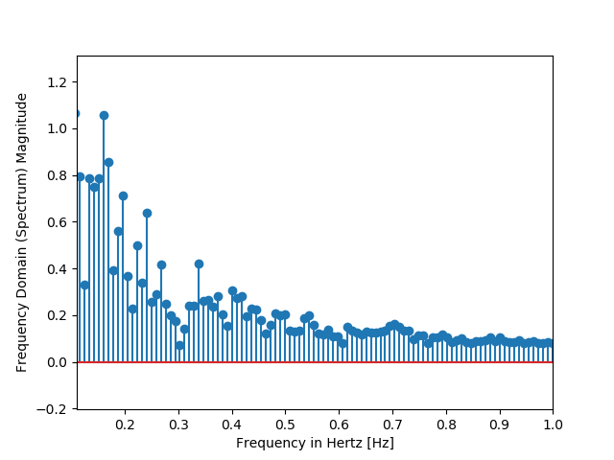

Improvements

Slide 23
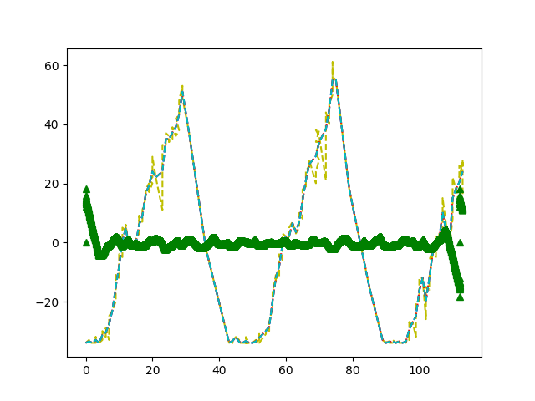
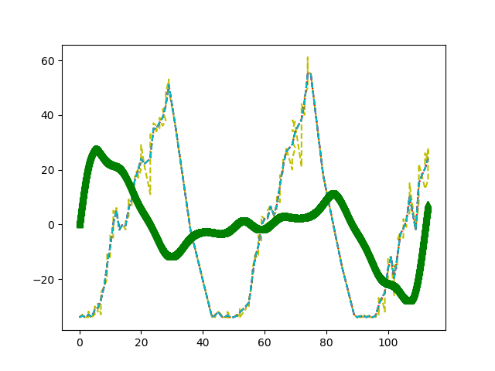
Improvements
Texture isolated from geometry
Geometry isolated from texture

Slide 24
Suggestions for future research
Which of the frequencies do you isolate or how much would you remove from their corresponding amplitudes?
Have a model which gives you information in terms of % texture and % geometry.
How does friction affect detection of texture and geometry? Any correlation?
Smart interrogation techniques – Based on classification X, what is the next exploratory procedure to further classify?

Slide 25
Thank you

